Slide 1
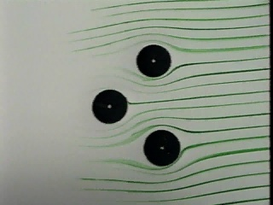
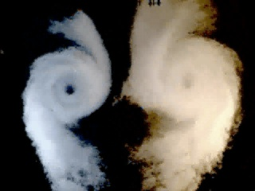
Fluid Kinematics
Fluid Mechanics
December 18, 2012

Slide 2
Fluid Flow Concepts and Reynolds Transport Theorem
Descriptions of:
fluid motion
fluid flows
temporal and spatial classifications
Analysis Approaches
Lagrangian vs. Eulerian
Moving from a system to a control volume
Reynolds Transport Theorem

Slide 3
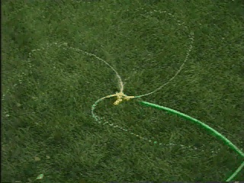
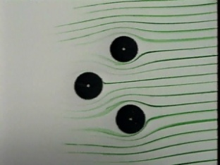
Descriptions of Fluid Motion
Defined instantaneously
streamline
has the direction of the velocity vector at each point
no flow across the streamline
steady flow streamlines are fixed in space
unsteady flow streamlines move
pathline
path of a particle
same as streamline for steady flow
streakline
tracer injected continuously into a flow
same as pathline and streamline for steady flow
Defined as particle moves (over time)
Draw Streamlines
Unsteady demo

Slide 4
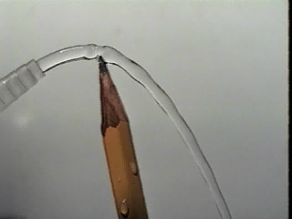
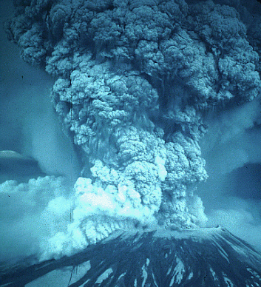
Descriptors of Fluid Flows
Laminar flow
fluid moves along smooth paths
viscosity damps any tendency to swirl or mix
Turbulent flow
fluid moves in very irregular paths
efficient mixing
velocity at a point fluctuates

Slide 5
Temporal/Spatial Classifications
Steady - unsteady
Uniform - nonuniform
Can turbulent flow be steady? _______ ________________ ________________
Changing in time
If averaged over a suitable time
Changing in space

Slide 6
Analysis Approaches
Lagrangian (system approach)
Describes a defined _____ (position, velocity, acceleration, pressure, temperature, etc.) as functions of time
Track the location of a migrating bird
Eulerian
Describes the flow ______ (velocity, acceleration, pressure, temperature, etc.) as functions of position and time
Count the birds passing a particular location
mass
field
If you were going to study water flowing in a pipeline, which approach would you use? ____________
Eulerian

Slide 7
The Dilemma
The laws of physics in their simplest forms describe systems (the Lagrangian approach)
Conservation of Mass, Momentum, Energy
It is impossible to keep track of the system in many fluids problems
The laws of physics must still hold in a Eulerian world!
We need some tools to bridge the gap

Slide 8
Reynolds Transport Theorem
A moving system flows through the fixed control volume
The moving system transports extensive properties across the control volume surfaces
We need a bookkeeping method to keep track of the properties that are being transported into and out of the control volume

Slide 9
Control Volume Conservation Equation
B =__________________________ in the system
Total amount of some property
b = Amount of the property ___________
per unit mass
Rate of increase of the property in the control volume
Rate of efflux of the property across the control volume boundary
Rate of increase of the property in the system
=
+

Slide 10
Summary
Reynolds Transport Theorem can be applied to a control volume of finite size
We don’t need to know the flow details within the control volume!
We do need to know what is happening at the control surfaces.
Conservation of mass (for all species)
Newton’s 2nd law of motion (momentum) _______
First law of thermodynamics (energy)
F = ma

Slide 11
Control Volume Conservation Equation
0 = -1 + (-0 + 1)
0 = 1 + (-1 + 0)
0 = 0 + (-0 + 0)

Slide 12
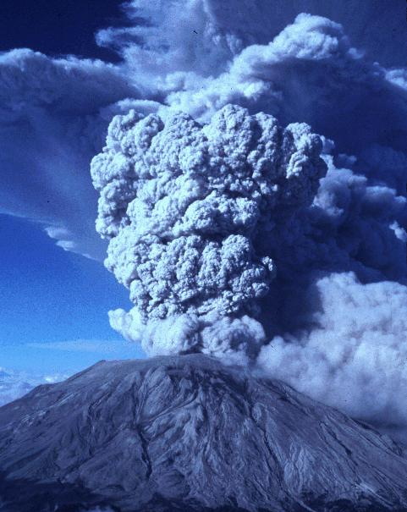
Mt. St. Helens

Slide 13
Application of Reynold’s Transport Theorem
Chemical with concentration C_{in} enters reactor with flow rate Q and exits with concentration C.
Chemical decays at rate kC
What is b? What is B?
What is ρb?
What is left side of equation?
What is ?
C/ρ
CV
C

